Slide 1
DAMAGEWIZ: COST CALCULATION OF CARS DAMAGED USING ARTIFICIAL INTELLIGENCE
Melisa Durmuş - 150119727
Hasan Şenyurt - 150120531
Cem Anaral - 150119761

Slide 2

AGENDA
01
Problem Description
Methodology & Technical Approach
05
Project Aims
Tasks Accomplished
02
06
Related Work
03
Difficulties Encountered
07
Scope
04
Tasks to be Completed in the Second Semester
08

Slide 3


What is the problem?
People go to mechanics when they have an accident, but the damage assessment process progresses very slowly
Another problem besides losing time during damage assessment is the cost of prediction of damaged parts
What is our solution?
We will develop a mobile application to detect the exterior damage of the vehicle using photos of damaged car
Application will suggest mechanic shops to repair the damaged car

Slide 4
Our Motivation
Making damage assessment process faster
Creating business opportunities to the mechanics
Making drivers’ life easier

Slide 5
Project Aims
Detecting the car brand
Developing a marketplace
Detecting the damaged car parts
Developing a rating mechanism
Detecting the percentage of damage
Developing a filtering mechanism to find the most suitable mechanic

Slide 6

Related Works
CarNet.AI
Tafazzoli et al.
Enterprise level API that can detect models and brands of the cars, developed by LastStar Ltd.
They proposed a two-stage framework to detect the brand and the model of cars. They used Multiple Instance Learning for high accuracy classification

Slide 7
Related Works
Chua et al.
Kunduracı et al.
A two-level machine learning based system is developed to detect three car parts:
Front bumper
Rear bumper
Car wheels
First level is for car part classification, the second one is for damage identification
A solution for detecting car brands is developed using a classification method based on Faster R-CNN

Slide 8


Name | Brand Detection | Model Detection | Damaged Part Detection | Damage Percentage Detection
Kunduracı et al.
CarNet.AI
Tafazzoli et al.
Chua et al.
Our Work
Table 1: Related Works Summarized

Slide 9
Scope
Constraints
Drivers
Mechanics
Car brand detection
Damage assessment
Listing required parts
Marketplace
Shown on map
Only available in Android mobile phones
Only automobiles
License plates in dataset must be blurred

Slide 10

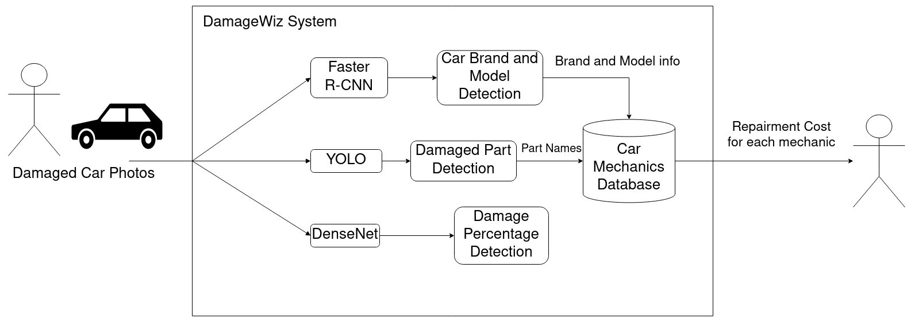
Methodology and Technical Approach
1
2
3
4
7
5
6

Slide 11

Tasks Accomplished
Data collection
Dataset of damaged and undamaged cars are collected from Kaggle
920 photos for damaged and undamaged cars for training, 230 photos for testing
DenseNet model is trained for detecting damaged or undamaged cars
Model is trained and created using Python
Simple GUI program is developed for first prototype

Slide 12
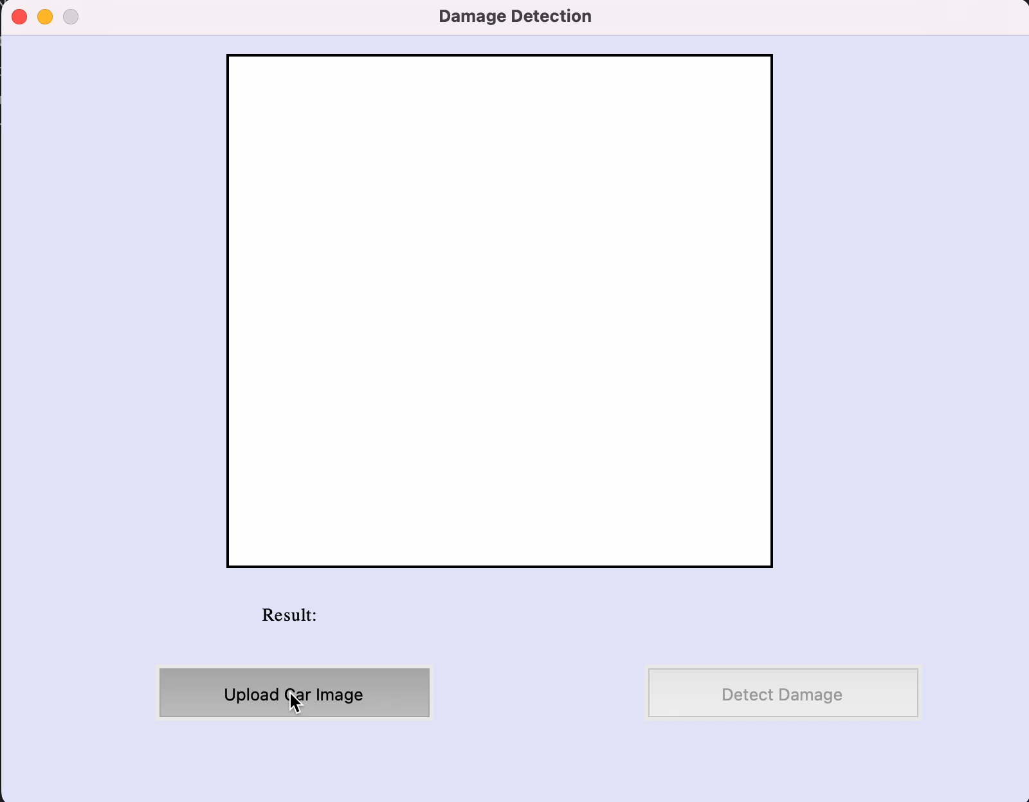

Slide 13

Difficulties Encountered
Understanding the core of AI, machine learning and deep learning in a short time to develop a model
First time of comprehensive project in terms of AI
Collecting labelled dataset in terms of location of the damage on the car

Slide 14
Tasks To Be Completed In The Second Semester
Mobile Application Development
Data Preparation
December
Presentation and Research
Keras Implementation
April
October
February
June
November
January
March
May
Literature Survey
Developing First Prototype
Data Preprocessing
Web Application Development
Testing and Deployment

Slide 15
References
[1] Kunduracı M. F., Kahramanli Örnek, H. “Vehicle Brand Detection Using Deep Learning Algorithms”. International Journal of Applied Mathematics Electronics and Computers 7 (2019): 70-74.
[2] CarNet.AI [Date of Access: 27/11/2022] [https://carnet.ai/make-model-recognition-api].
[3] Tafazzoli F., Frigui H. “Vehicle Make and Model Recognition Using Local Features and Logo Detection”. International Symposium on Signal, Image, Video and Communications (ISIVC) (2016): 353-358.
[4] Chua A. C. et al. “Damage Identification of Selected Car Parts Using Image Classification and Deep Learning”. IEEE 13th International Conference on Humanoid, Nanotechnology, Information Technology, Communication and Control, Environment, and Management (HNICEM) (2021): 1-5.
[5] Gandhi R. “R-CNN, Fast R-CNN, Faster R-CNN, YOLO — Object Detection Algorithms” [Date of Access: 15/11/2022]
[6] Pleiss G, Chen D, Huang G, Li T, Van Der Maaten L, Weinberger KQ “Memory-efficient implementation of dense nets” CoRR (2017).
[7] Girshick R., Donahue J., Darrel T., Malik J. “Rich feature hierarchies for accurate object detection and semantic segmentation”. IEEE Conference on Computer Vision and Pattern Recognition (2014): 580-587.

Slide 16

Thank You For Listening!
->> Questions?
<<- Answers
|> Contributions…

